Slide 1

Dissertation – Week 7
University of Oxford – OMMS
Kim López Güell

Slide 2
What I did last week
Practically wrote the whole paper (“Paper_draft.odt” in Dropbox):
  Polished all the plots and tables
  Wrote Methods
  Wrote Results
  Wrote Discussion
  Wrote Abstract
  Wrote Introduction

Slide 3
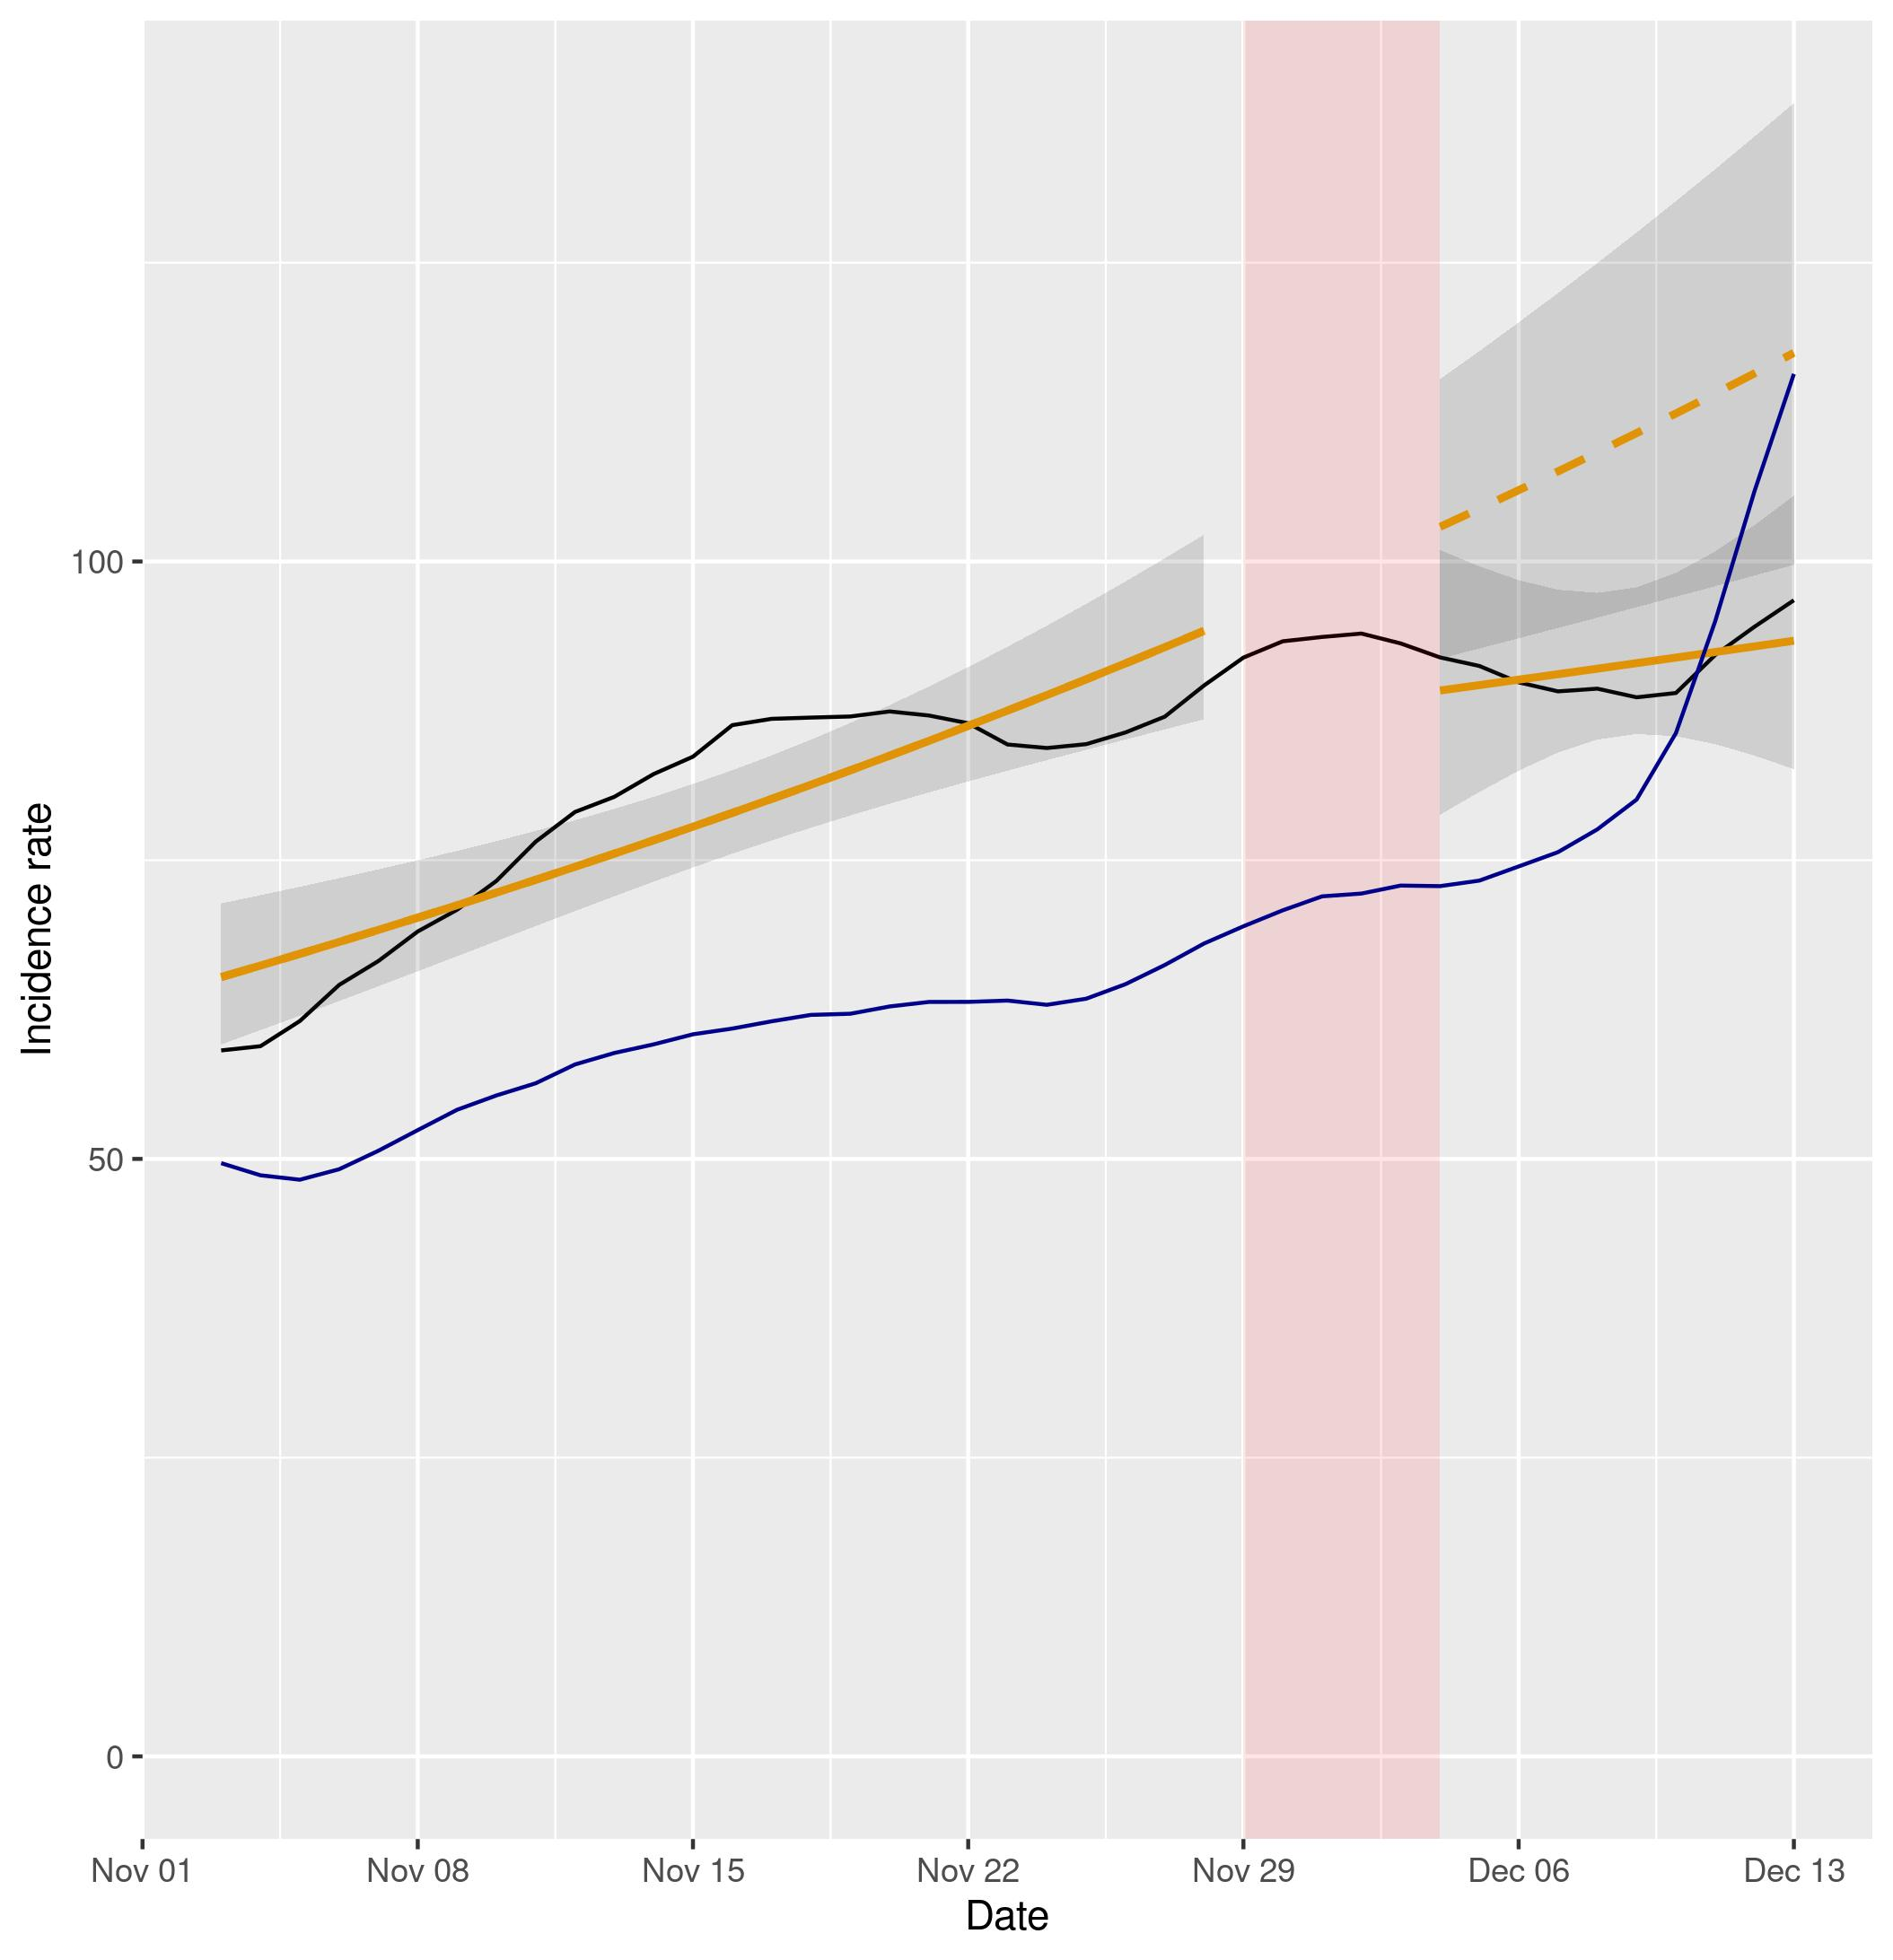
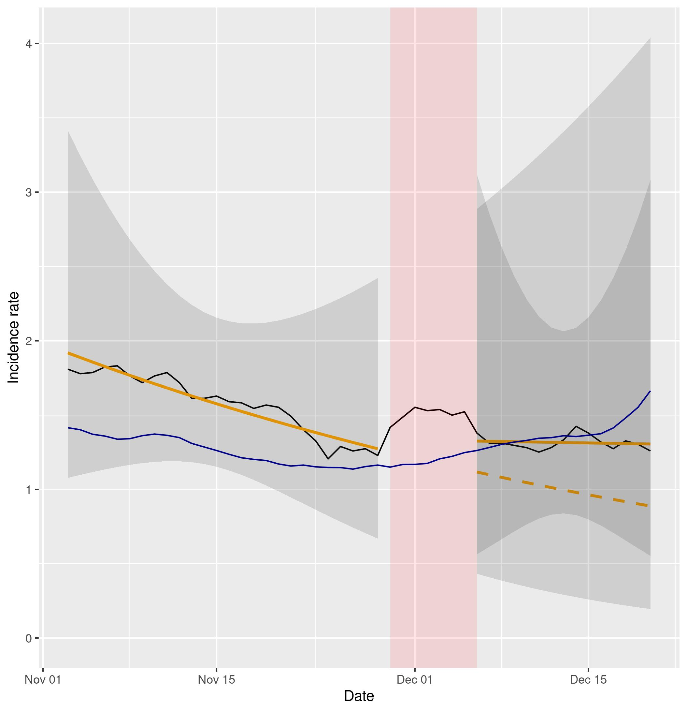
Negative binomial segmented regression
Example of SR plot (Northern Ireland, cases and hospital admissions)

Slide 4
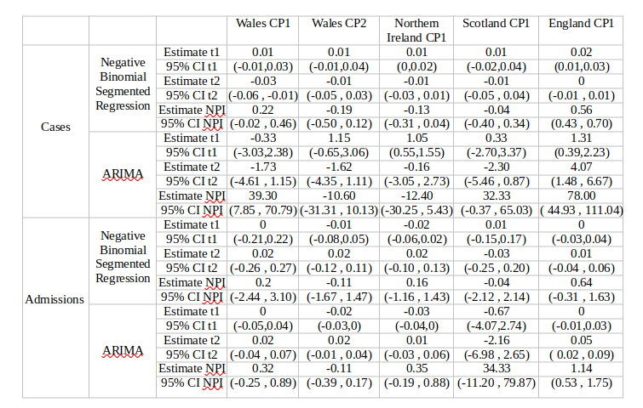
ARIMA models

Slide 5
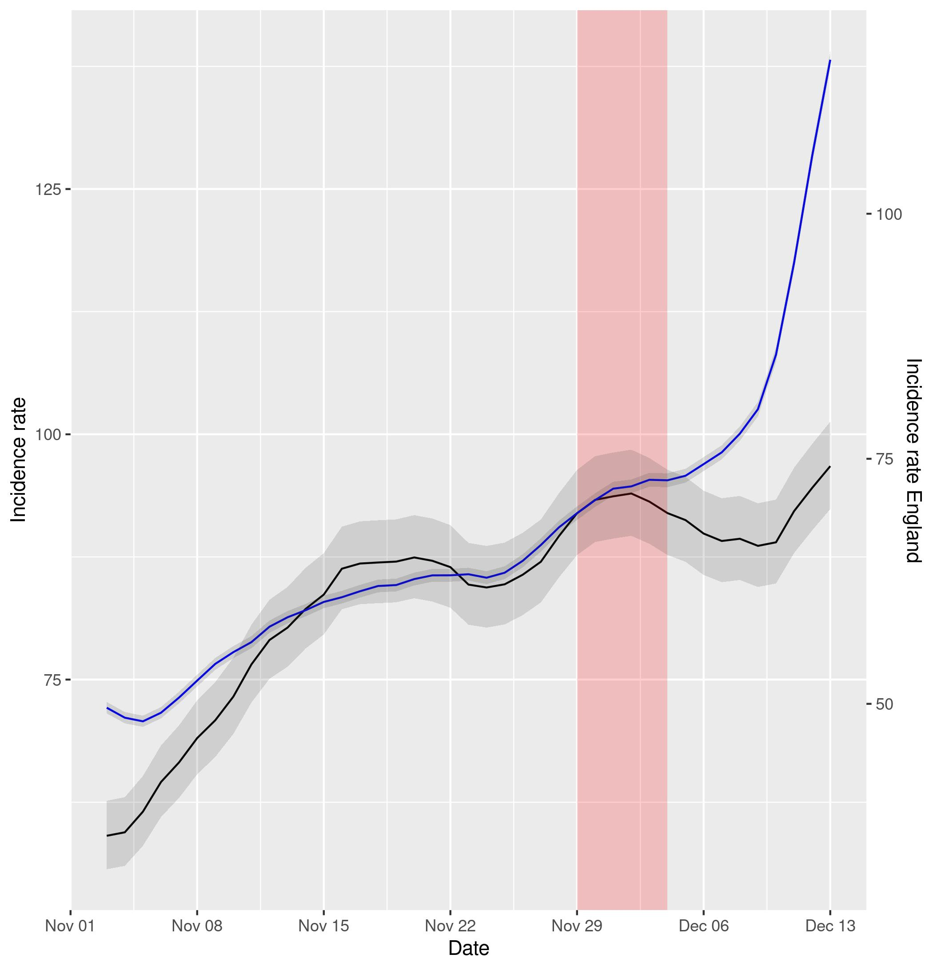
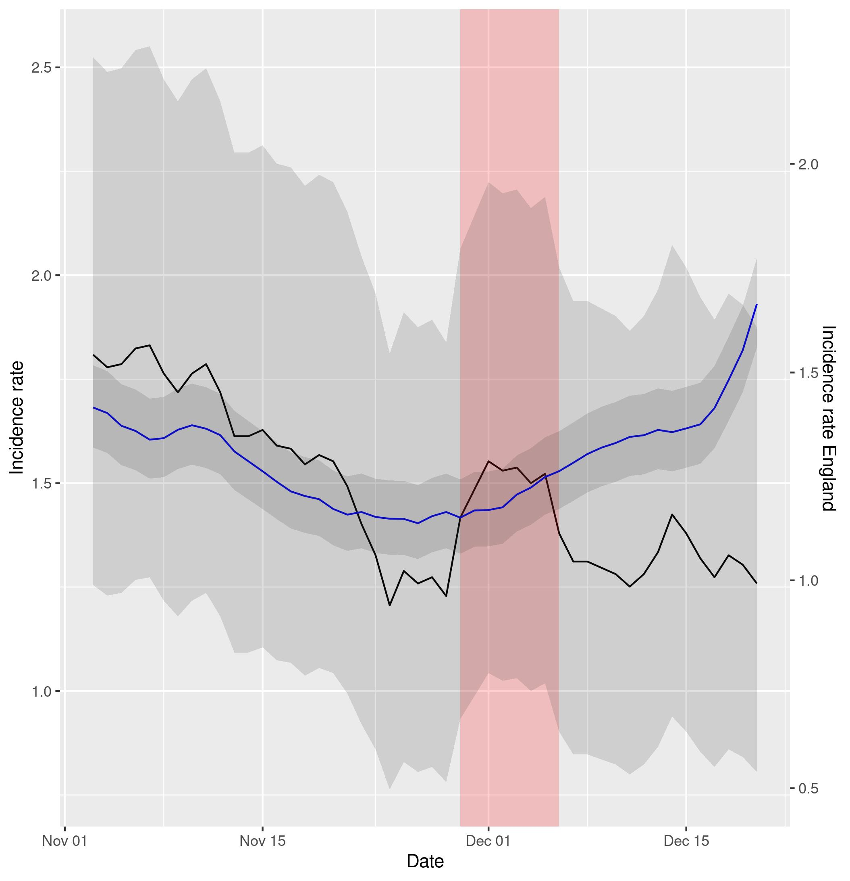
Difference-In-Differences
Example of DID plot (Northern Ireland, cases and hospital admissions)

Slide 6
What I will do next week
Write Supplementary Material
Hopefully have a polished draft at the end of the week
Talk to Professor Hein and Professor Prieto-Alhambra about the Dissertation
Plan what I will include in the Dissertation as well afterwards

